Slide 1

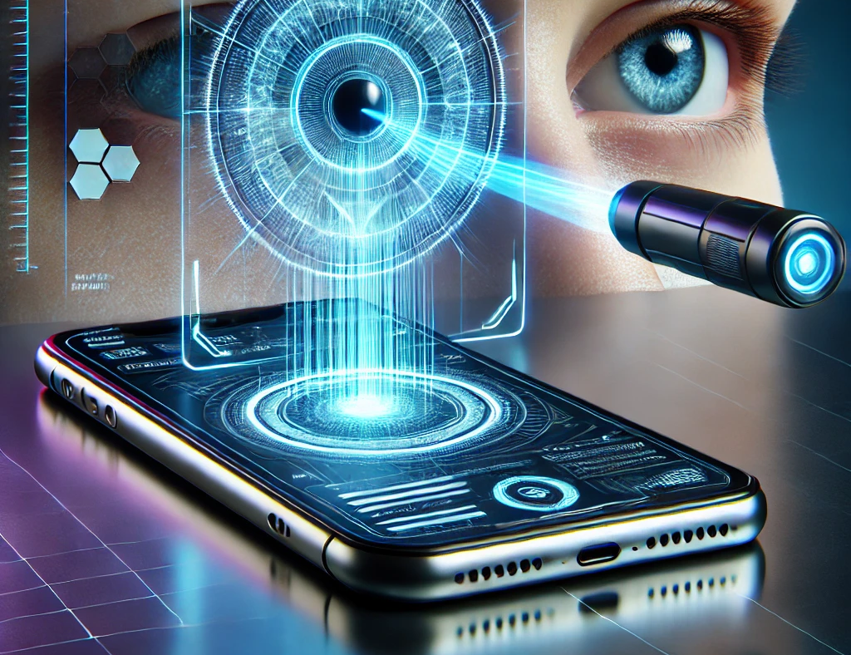
EyeNet AI-Driven Early Eye Conditions Detection using Video Analysis
Capstone Project Phase A
Project Code: 25-1-D-3
Gal Bitton
Ron Bendel
Supervisors:
Mrs. Elena Kramer
Dr.Dan Lemberg
Notes:
Hello everyone, welcome to our Capstone project phase A presentation.
My name is Ron Bendel and this is Gal Bitton, our supervisors are Mrs. Elena Kramer, and Dr. Dan Lemberg.
We are excited to introduce you to EyeNet, an AI-Driven early eye conditions detection using video analysis.
Imagine if instead of waiting for a doctor’s appointment so long, you could just analyze your eye status with your mobile device.

Slide 2

Table of Contents
3
Introduction
4
Proposed Solution
5
System Workflow
6
Face & Eye Detection
7-8
DLib
9-12
Keras Models
13-14
DenseNet121
15
Attention Mechanism
16
Architecture
17
Expected Challenges
18
Evaluation Plan
19-23
GUI
Introduction
Proposed Solution
Sys’ Workflow
Face&Eye Detection
DLib
Keras Models
DenseNet121
Attention Mechanism
Architecture
Expected Challenges
Evaluation Plan
GUI
Notes:
So, let’s take a quick look at the topics we are going to talk about during this
presentation.
You can see there all the topics, and during this presentation we
have the table of contents at the bottom of the slides, where you can always find
in which topic we are.

Slide 3
Introduction
High global prevalence of preventable eye conditions
Lack of accessible, user-friendly diagnostic tools
Existing solutions focus on one eye condition,
Our solution will focus on 3 different conditions : Cataracts, Conjunctivitis, Styes
Traditional diagnostic methods require a doctor’s appointment and the presence of specialized equipment.
EyeNet bridges this gap by using AI-Driven video analysis
3
Introduction
Proposed Solution
Sys’ Workflow
Face&Eye Detection
DLib
Keras Models
DenseNet121
Attention Mechanism
Architecture
Expected Challenges
Evaluation Plan
GUI
Notes:
As you may noticed our application is connected to eyes diagnosis.
We read and found that 2.2 billion people around the world suffer from different eye conditions, where almost 50% of them suffer from cataracts.
We did some research over the internet and read many articles and we realized that there are lack of accessible, user-friendly diagnostic tools.
Most of the solutions we found were focused on one eye condition, or even if they focused more than one eye condition they mostly focused on internal eyes
photos, like the photos you take from a doctor or hospital.
Our solution will focus on 3 different conditions such as Cataracts, Conjunctivitis and styes.
The traditional diagnostic methods require mostly a doctor’s appointment, and
for peripheral areas like we came from it may be difficult to schedule one.
This is where EyeNet comes and bridges this gap, by using AI-Driven video
analysis.

Slide 4
Proposed Solution
Video Decomposition using OpenCV
Face and Eye Detection using DLib
Eye Conditions Detection using EyeNet Model
User-Friendly Interface
4
Introduction
Proposed Solution
Sys’ Workflow
Face&Eye Detection
DLib
Keras Models
DenseNet121
Attention Mechanism
Architecture
Expected Challenges
Evaluation Plan
GUI
Notes:
In order to describe our proposed solution we can see in the following scheme, that we have 4 main steps:
Video Decomposition using OpenCV – we are allowing the user to upload a video so we will be able to achieve higher accuracy processing many frames.
Face and Eye detection using Dlib – actually the main issue in our solution, we have to detect and face and the eyes from each frame, in order to do that we use dlib library.
Eye Conditions Detection using EyeNet model – after we detected the eyes, we pass the image to the model in order to predict and classify the eye conditions.
And last one during the whole process we have a user-friendly interface developed as React web application, where the user can see his results etc.

Slide 5
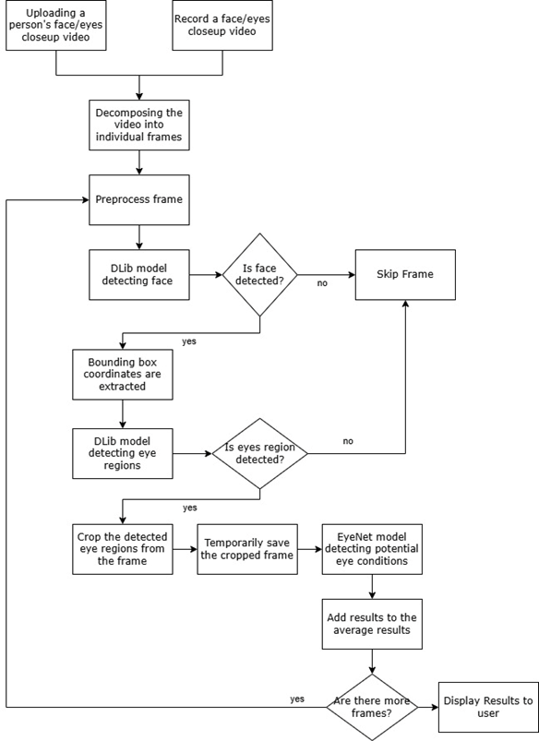
System Workflow
5
Introduction
Proposed Solution
Sys’ Workflow
Face&Eye Detection
DLib
Keras Models
DenseNet121
Attention Mechanism
Architecture
Expected Challenges
Evaluation Plan
GUI
Notes:
Let’s take a short quick view over the system’s workflow.
The process starts from top to bottom, as you can see the user can upload a video or record a video in our application, then the process is the same.
We decomposing the video into frames, and for each frame try to detect the eyes, crop them, and send them to the model, so at the end of the process we will have the most accurate average score from all valid frames.

Slide 6
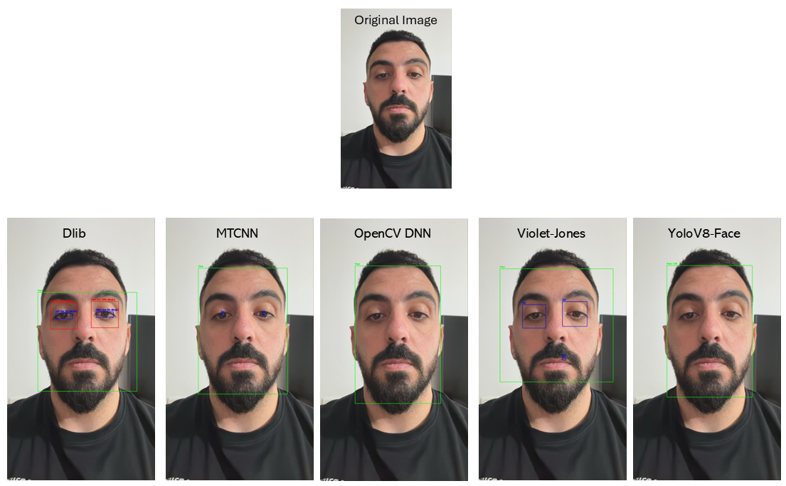
Face and Eye Detection
Algorithm | Strengths | Limitations
Viola-Jones | Fast, lightweight | Low accuracy in dynamic settings
MTCNN | High accuracy, multi-task learning | Slower processing on large inputs
YOLO | Real-time performance | Requires high GPU capabilities
OpenCV | Optimized for lightweight tasks | Limited robustness
DLib | Precise landmark detection | Computationally intensive
6
Introduction
Proposed Solution
Sys’ Workflow
Face&Eye Detection
DLib
Keras Models
DenseNet121
Attention Mechanism
Architecture
Expected Challenges
Evaluation Plan
GUI
Notes:
As we mentioned before, one of the main issues in our solution is the face and eyes detection.
In order to find the best algorithm for us, we checked over 5 algorithms used in Object Detection field.
We can see the results in the right image. This is just a simple 1 test from many cases we’ve checked, and all found out that Dlib actually achieved the most accurate results.

Slide 7
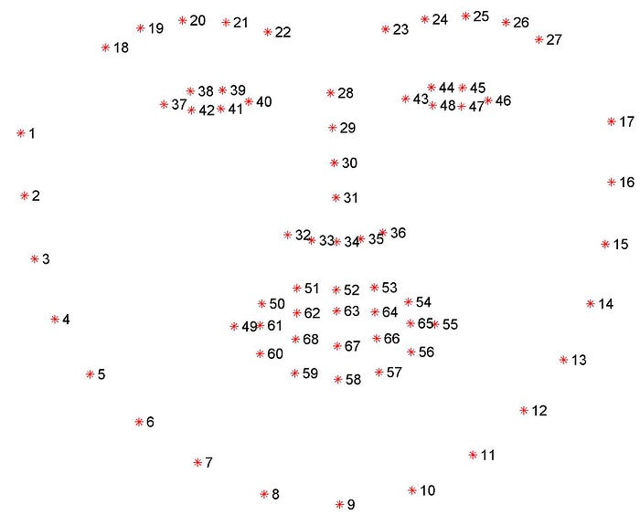

DLib
DLib is a general-purpose C++ library for machine learning and computer vision tasks.
Widely used for tasks such as:
Face Detection
Facial Landmarks prediction
Object detection
In EyeNet, we are using Dlib’s HOG (Histogram of oriented gradients) + SVM face detector and 68-point facial landmark predictor.
Points 37-48 relevant for eye’s area
7
Introduction
Proposed Solution
Sys’ Workflow
Face&Eye Detection
DLib
Keras Models
DenseNet121
Attention Mechanism
Architecture
Expected Challenges
Evaluation Plan
GUI
Notes:
So, what is dlib actually? Dlib is a general-purpose C++ library for machine learning and computer vision tasks.
It’s widely used for tasks such as face detection, facial landmarks predictions and object detection.
We are using Dlib’s HOG + SVM detector version. In the right image you can see the 68-facial landmarks for the Dlib algorithm.
You can see there the eyebrows, the eyes, nose, mouth, and all the face actually. We are focusing on points 37-48, those are the relevant for eye’s area.

Slide 8
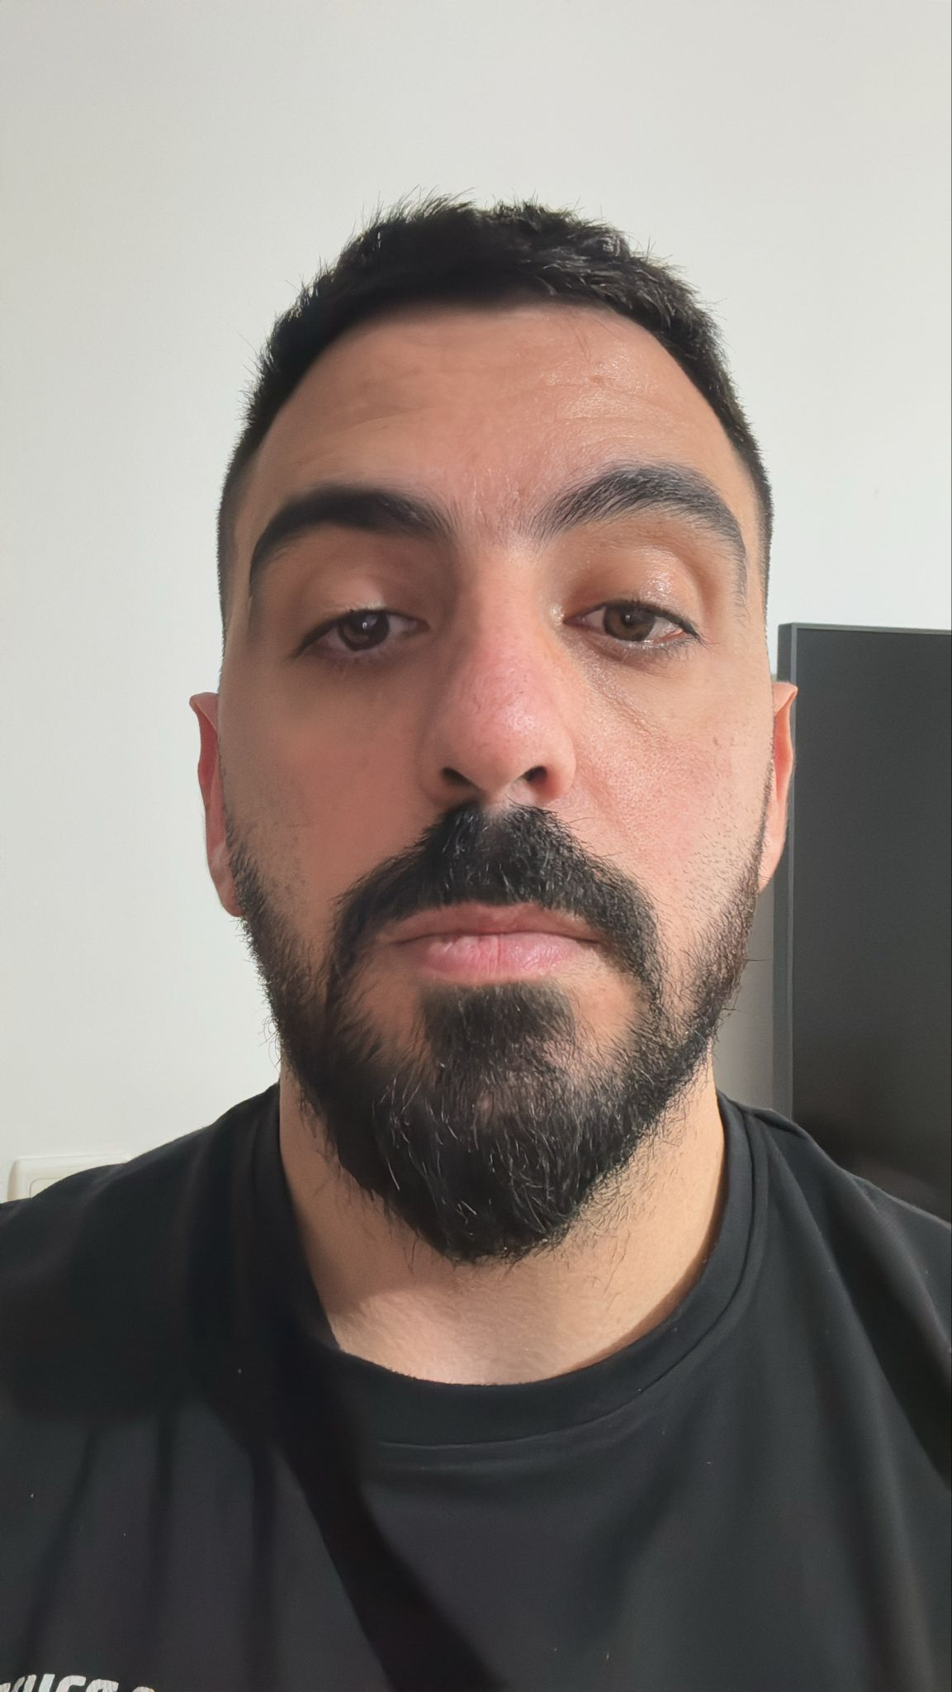
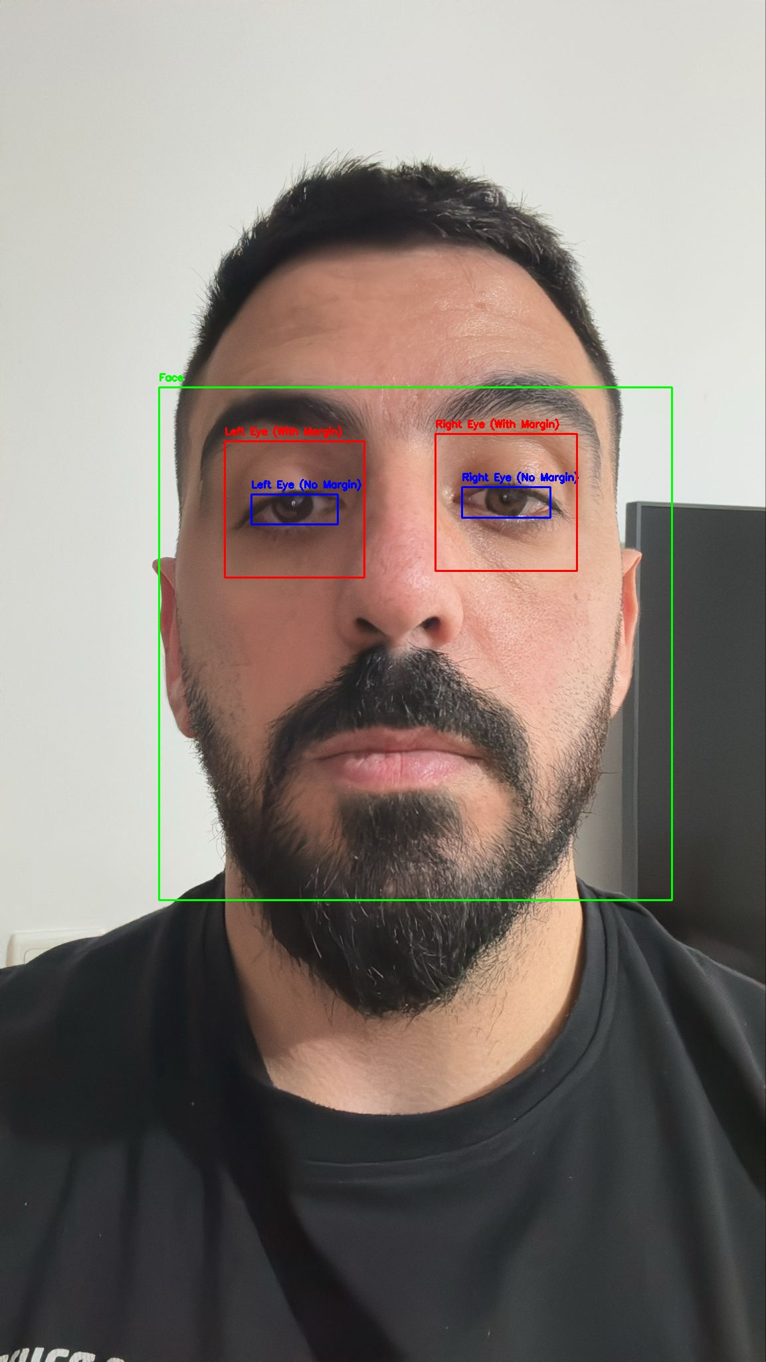
DLib’s Flow
Histogram of Oriented Gradients (HOG)
Extracts gradient orientations from localized image patches
Creates a robust feature descriptor
Linear Support Vector Machine (SVM)
Uses extracted HOG features to classify regions as “face” or “non-face”.
SVM Model
Noise Removal
HOG Feature Descriptor
Face and Eye Detection
8
Introduction
Proposed Solution
Sys’ Workflow
Face&Eye Detection
DLib
Keras Models
DenseNet121
Attention Mechanism
Architecture
Expected Challenges
Evaluation Plan
GUI
Notes:
We will cover the algorithm at high level because this is not the main of our application, but just a quick overview.
HOG is an Histogram of oriented gradients which extracts gradient orientations from the localized image patches.
And create a feature descriptor. This descriptor is passes to the SVM Model, using classifications if this is “Face” or not face, and extract all the facial landmarks detected.

Slide 9
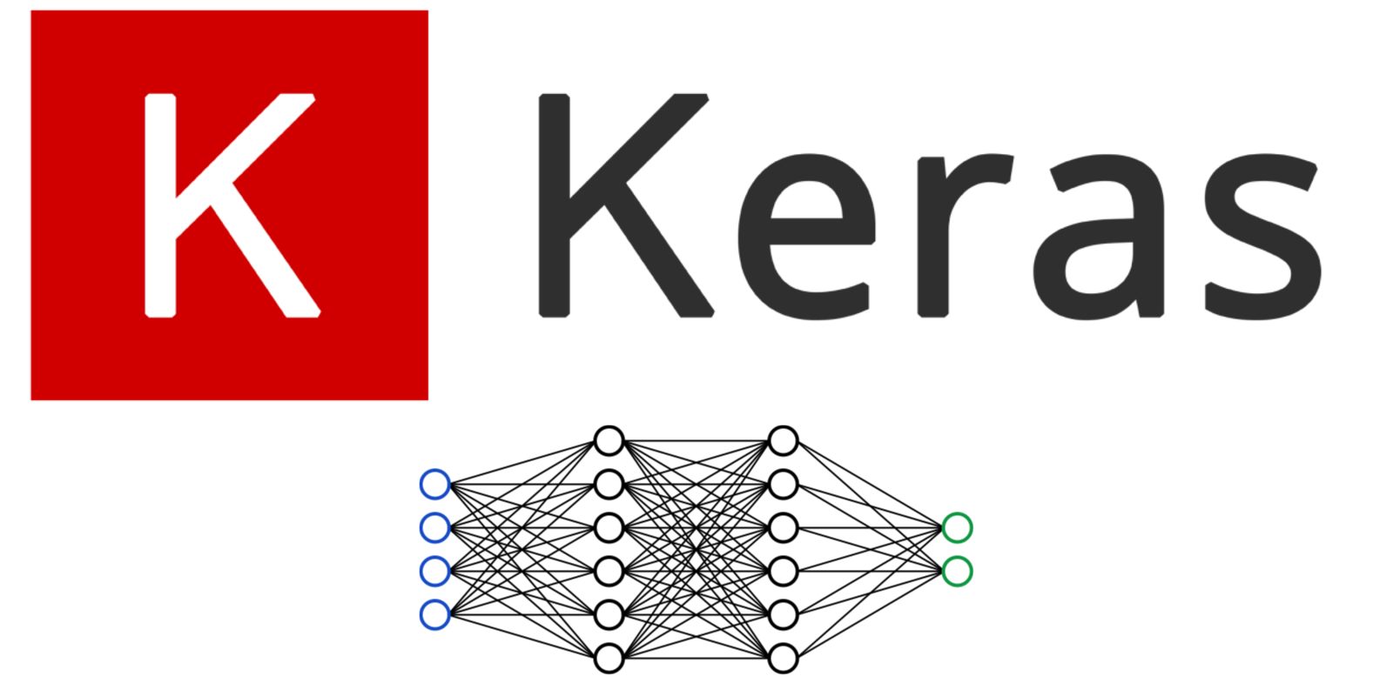
Keras Models
Keras is an open-source deep learning framework that provides a user-friendly and high-level API for building and training deep neural networks.
Deep learning models requires high-quality hardware and enough computing power to train complex models.
We run the models on our personal computers.
The limited computational power is not enough for training deep learning models.
From Keras.io site: “Keras Applications are deep learning models that are made available alongside pre-trained weights. These models can be used for prediction, feature extraction, and fine-tuning.”
For EyeNet we tested four pre-trained models: VGG16, ResNet50, Inception V3 and DenseNet-121.
9
Introduction
Proposed Solution
Sys’ Workflow
Face&Eye Detection
DLib
Keras Models
DenseNet121
Attention Mechanism
Architecture
Expected Challenges
Evaluation Plan
GUI
Notes:
As you noticed EyeNet is actually a deep learning model.
Deep learning models requires high-quality hardware and enough computing power to train complex models.
In our case, we run the models on our personal computers, and the limited computational power is not enough for training deep learning models from scratch.
Keras applications are deep learning models that are made available alongside pre-trained weights.
These models can be used for prediction, feature extraction and fine-tuning.
So, for our solution EyeNet we’ve tested four pre-trained models: VGG16, ResNet50, Inception V3 and DenseNet-121.

Slide 10
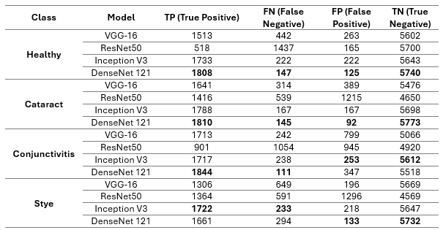
Keras Models Benchmarks
Confusion Matrix for each class, testing on 4 Keras pre-trained models
10
Introduction
Proposed Solution
Sys’ Workflow
Face&Eye Detection
DLib
Keras Models
DenseNet121
Attention Mechanism
Architecture
Expected Challenges
Evaluation Plan
GUI
Notes:
Let’s talk a little about the benchmarks we found out.
Here we can see a confusion matrix for each class, testing on 4 keras pre-trained models.
The results emphasize that DenseNet-121 actually leads for all classes. It achieved the highest scores.

Slide 11
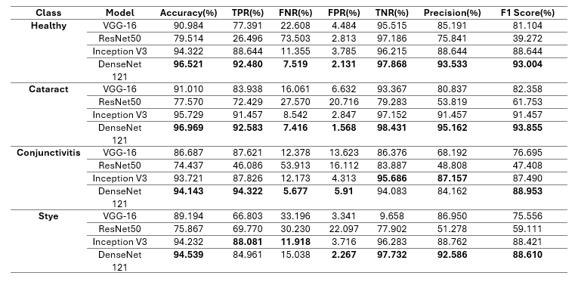
Keras Models Benchmarks
Performance evaluation matrices for all 4 Keras pre-trained models
11
Introduction
Proposed Solution
Sys’ Workflow
Face&Eye Detection
DLib
Keras Models
DenseNet121
Attention Mechanism
Architecture
Expected Challenges
Evaluation Plan
GUI
Notes:
Another benchmark is the performance evaluation matrices for all 4 keras pre trained models.
Again, here we see the DenseNet-121 actually got the highest accuracy and performance according to the other models.

Slide 12
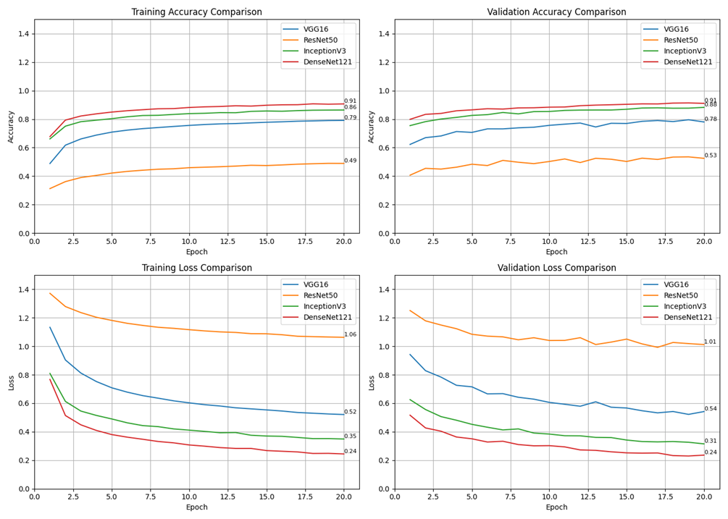
Keras Models Benchmarks
Visualization of the pre-trained models training and validation process
Despite the high results, it is important to note that DenseNet-121 did not achieve good results during our testing.
12
Introduction
Proposed Solution
Sys’ Workflow
Face&Eye Detection
DLib
Keras Models
DenseNet121
Attention Mechanism
Architecture
Expected Challenges
Evaluation Plan
GUI
Notes:
And those graphs are the visualizations of the table we saw before.
It’s important to notice that despite the high results which actually made us surprised.
DenseNet-121 did not achieve good results during our testing.
On the dataset it achieved high score, but in real cases we wanted to test on, it failed.

Slide 13
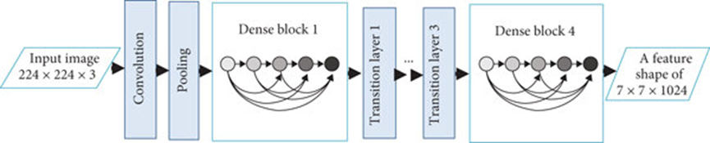
DenseNet121
Dense Block 2
Dense Block 3
56x56
1x1 conv x6
3x3 conv x6
28x28
1x1 conv x12
3x3 conv x12
14x14
1x1 conv x24
3x3 conv x24
7x7
1x1 conv x16
3x3 conv x16
DenseNet121 is a deep neural network with 121 layers, leveraging dense connectivity to improve efficiency and performance.
Dense Connectivity: Each layer connects to all preceding layers, enhancing feature reuse and mitigating the vanishing gradient issue.
Compact Architecture: Approximately 8 million parameters, making it computationally efficient.
Excels in tasks like image classification and object detection.
112x112
7x7 conv, stride 2
Transition layer 2
56x56
1x1 conv
28x28
14x14
1x1
13
Introduction
Proposed Solution
Sys’ Workflow
Face&Eye Detection
DLib
Keras Models
DenseNet121
Attention Mechanism
Architecture
Expected Challenges
Evaluation Plan
GUI
Notes:
Hey everyone, my name is gal, and I will continue Ron.
So after we saw the benchmarks, we chose to take DenseNet-121to be our base model for EyeNet.
But as ron said, for the real-cases scenarios DenseNet-121 did not achieved good performance.
So what is dense net actually? DenseNet-121 is a deep neural network with 121 layers, leveraging dense connectivity in order to improve efficiency and performance.
The main idea of DenseNet is the dense connectivity, which means that each layers connects to all preceding layers enhancing feature reuse and mitigating the vanishing gradient issue.
It excels in tasks like image classification and object detection which this is exactly what we were looking for.

Slide 14

DenseNet121-What is Dense Block?
What is a Dense Block?
A series of layers where each layer receives inputs from all previous layers and passes its output to all subsequent layers.
Operations: Batch Normalization, ReLU, 1×1 Convolution, and 3×3 Convolution.
Purpose:
Maximizes feature reuse, reducing redundancy.
Facilitates better learning and efficient computation.
Outcome:
Extracts rich, hierarchical features.
Improves learning dynamics for deeper architectures.
14
Introduction
Proposed Solution
Sys’ Workflow
Face&Eye Detection
DLib
Keras Models
DenseNet121
Attention Mechanism
Architecture
Expected Challenges
Evaluation Plan
GUI
Notes:
The main idea we wanted to take from DenseNet121 was the dense blocks.
This is a series of layers where each layer receives inputs from all previous layers and passes it’s output to all subsequent layers.
This helps us to extract rich, hierarchical features and improves the learning.
In our case, we classify between 3 different eye conditions, where for cataract the model needs to learn to focus on the pupil, while for
conjunctivitis the model have to learn to focus on the sclera, and for styes it should focus on the eyelid, actually the whole eye area.
So we have many features and we want the model to be able to extract them.

Slide 15
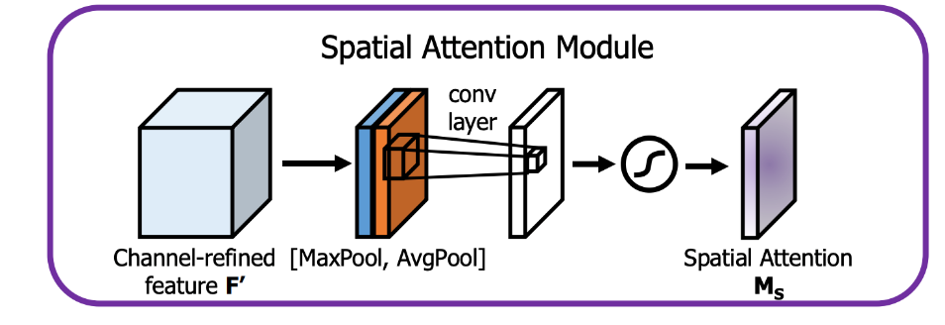
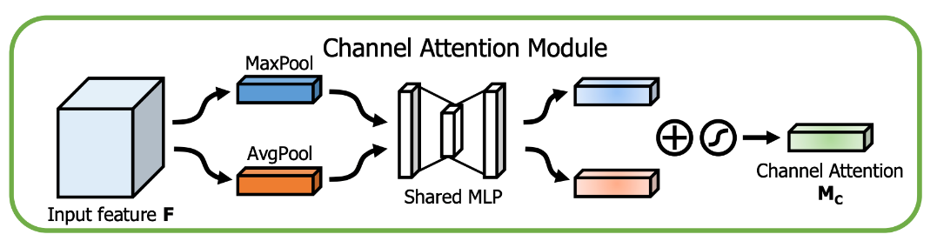
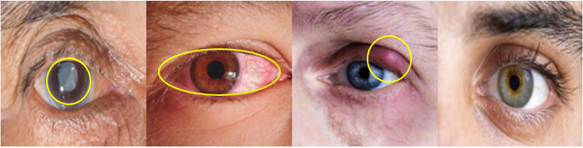


Attention Mechanism
Channel attention focuses on “what” is important (channels), while spatial attention focuses on “where” it is important (spatial regions).
Spatial Attention Mechanism
Focus on important spatial regions in the feature map.
Combines MaxPool and AvgPool across channels to form a 2D descriptor.
Passes the combined output through a convolutional layer.
Applies a sigmoid function to generate spatial attention ($M_{S}$)
Enhances spatially relevant areas in the input features.
Channel Attention Mechanism
Focus on important feature channels.
Applies MaxPool and AvgPool to the input feature map independently.
Pooled features pass through a shared MLP (Multi-Layer Perceptron).
Combines outputs via element-wise addition and passes through a sigmoid function to generate channel attention ($M_{C}$​ )
Highlights significant channels while suppressing less important ones
15
Introduction
Proposed Solution
Sys’ Workflow
Face&Eye Detection
DLib
Keras Models
DenseNet121
Attention Mechanism
Architecture
Expected Challenges
Evaluation Plan
GUI
Notes:
After many articles about how to improve CNN Models, how to achieve better feature extractions and even some inspiration from Yolo architecture.
We decided to add attention mechanism to our model. What is attention mechanism actually? We separate it to 2 different types.
We have the Channel attention which focuses on the channels of the image and tells the model “what” is important to look for.
And we have the spatial attention which focuses on “where” it is important.
Actually, by using those attention mechanism, we let the model to learn not only from Local context of the pixels, we let the model to learn from global context, how this pixel connects to the other pixels.
And we assume it will let the model to be more accurate and achieve better performance and results.

Slide 16
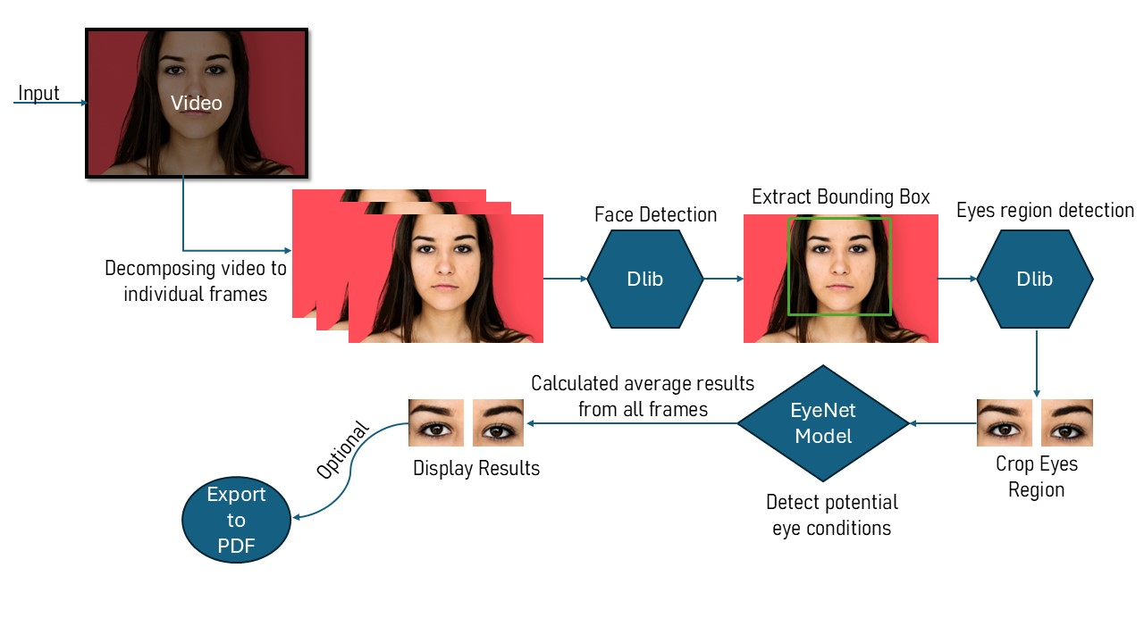
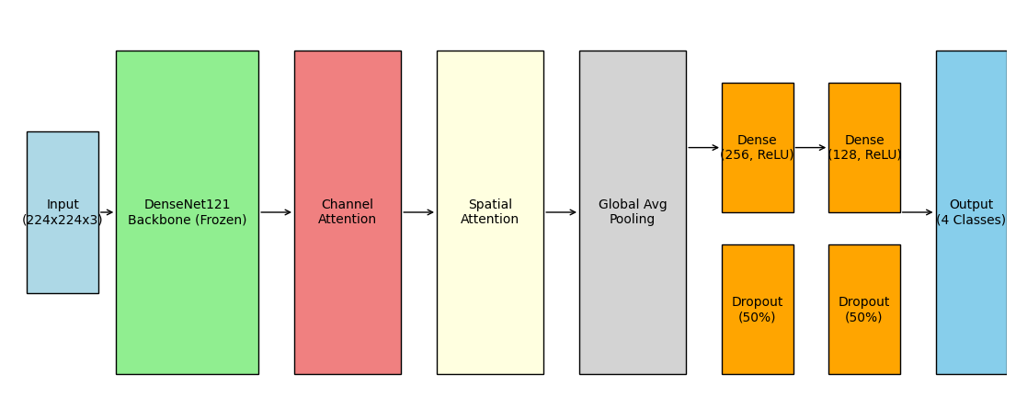
Architecture
EyeNet Model Architecture
EyeNet Application Architecture
16
Introduction
Proposed Solution
Sys’ Workflow
Face&Eye Detection
DLib
Keras Models
DenseNet121
Attention Mechanism
Architecture
Expected Challenges
Evaluation Plan
GUI
Notes:
As I’ve mentioned earlier, EyeNet is based on DenseNet-121 with 2 additional layers of attention mechanism.
DenseNet-121 will be the base backbone of the model, while the extracted features from the DenseNet-121 will pass through channel attention and spatial attention,
in order to focus more on the relevant features. We assume this architecture will improve the features extraction and the performance of the model.
On the right side of the slide, you can see the architecture in more visualized way.
We have the video as an input, decompose it to frames, then each frames going through the pipeline of face & eyes detection,
cropping the eyes, predicting using EyeNet and display the results at the end.

Slide 17
1
Proper diagnosis and treatment of image disturbances (blur, lighting conditions)
Expected Challenges
2
Building a reliable application with a user-friendly interface
3
Achieving high accuracy across diverse data inputs.
4
Compatibility with different devices and different image qualities
17
Introduction
Proposed Solution
Sys’ Workflow
Face&Eye Detection
DLib
Keras Models
DenseNet121
Attention Mechanism
Architecture
Expected Challenges
Evaluation Plan
GUI
Notes:
For the expected challenges we chose to discuss about 4 challenges.
EyeNet supports video processing, not all the frames in the video are clear enough to process it. Some of the frames may include some disturbances such as blur, lighting conditions and more. We want EyeNet to be able to overcome it.
At the end, we want the customers to use EyeNet. In order to do that, we have to build a reliable application with user-friendly interface. To make it accessible for the end-to-end user.
Connected to bullet number 1, we want EyeNet to achieve high accuracy on many different kinds of data inputs, such as noisy images, blurred images, and many more.
The purpose of EyeNet is to be as an application you can use from each device. Each different device probably will have different camera resolution which lead to different image qualities. We want to support that also.

Slide 18
Evaluation Plan
Goals
Eye condition detection with high accuracy
Efficient video processing
User-friendly interface
Performance
Classification accuracy>90%
Video’s process time <=15 seconds
Robustness
Handle poor image conditions
Provide clear error messages
User Satisfaction
Collect feedback from users
Testing Approach
Test with real-world datasets
Test EyeNet with eye’s doctor and real patients
18
Introduction
Proposed Solution
Sys’ Workflow
Face&Eye Detection
DLib
Keras Models
DenseNet121
Attention Mechanism
Architecture
Expected Challenges
Evaluation Plan
GUI
Notes:
When we are talking about our evaluation plan, we actually focusing on 5 main topics.
Goals: first, obviously our goal is to detect eye conditions with high accuracy. We want to have efficient video processing, and a user-friendly interface.
Performance: we assume that with DenseNet-121 and attention mechanism we will be able to get at least classification accuracy above 90. And we want the video’s process time to be low as possible.
Robustness: as I said before, we want to handle poor image conditions, and we will provide clear error messages to the users in order to keep the application user friendly.
User Satisfaction: we will collect feedback and tickets from the users.
Testing Approach: We want to make sure our model is reliable and we want to test is with real-world datasets. If we will be able to

Slide 19
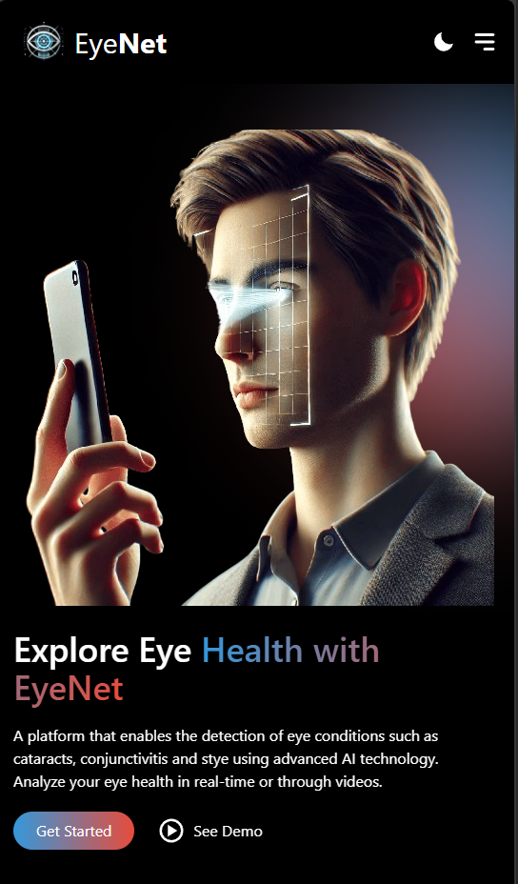
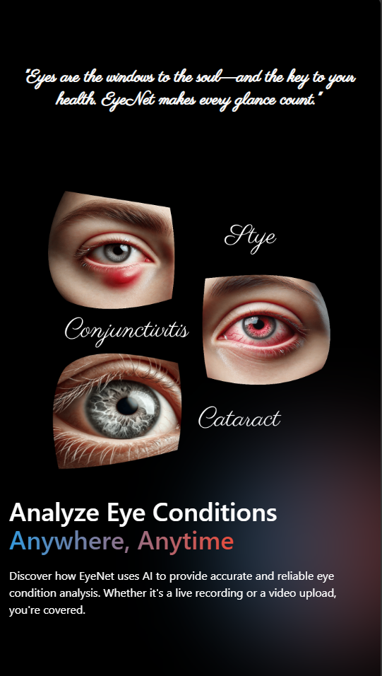
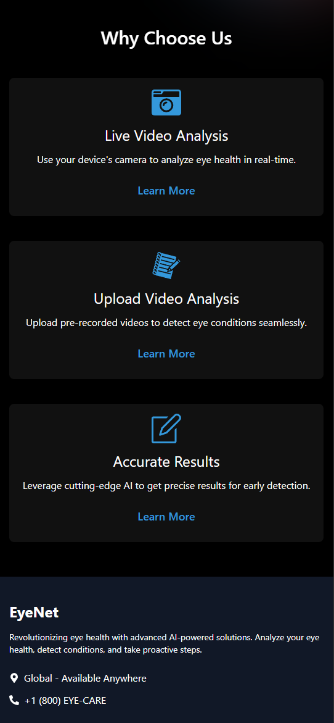
19
Introduction
Proposed Solution
Sys’ Workflow
Face&Eye Detection
DLib
Keras Models
DenseNet121
Attention Mechanism
Architecture
Expected Challenges
Evaluation Plan
GUI
Notes:
A quick look over the GUI.
Here we can see the landing page, there is “see demo” button which will display a video of our solution.
In addition, there is Get Started button which we will explain in the next slide.
Below you can see the eye conditions we support, and some cards with explanations for the users.

Slide 20
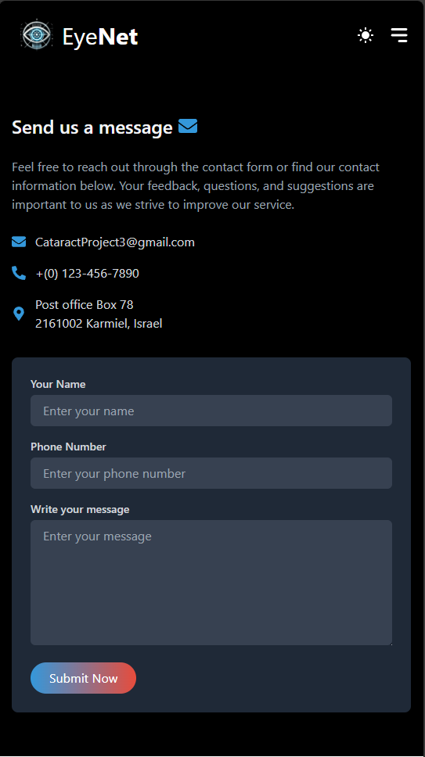
20
Introduction
Proposed Solution
Sys’ Workflow
Face&Eye Detection
DLib
Keras Models
DenseNet121
Attention Mechanism
Architecture
Expected Challenges
Evaluation Plan
GUI
Notes:
As we said before, we want to collect feedbacks from the users, this page is the contact us page.

Slide 21

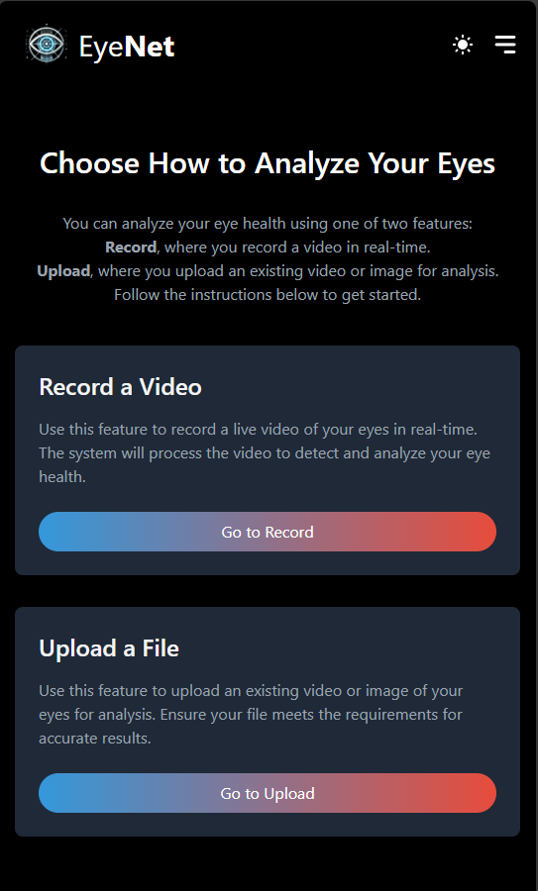
After clicking on Get Started
21
Introduction
Proposed Solution
Sys’ Workflow
Face&Eye Detection
DLib
Keras Models
DenseNet121
Attention Mechanism
Architecture
Expected Challenges
Evaluation Plan
GUI
Notes:
After the user click on Get Started, we move to this page which includes all instructions for the user of how to use our system.
The user can choose between record a video or upload a file.

Slide 22
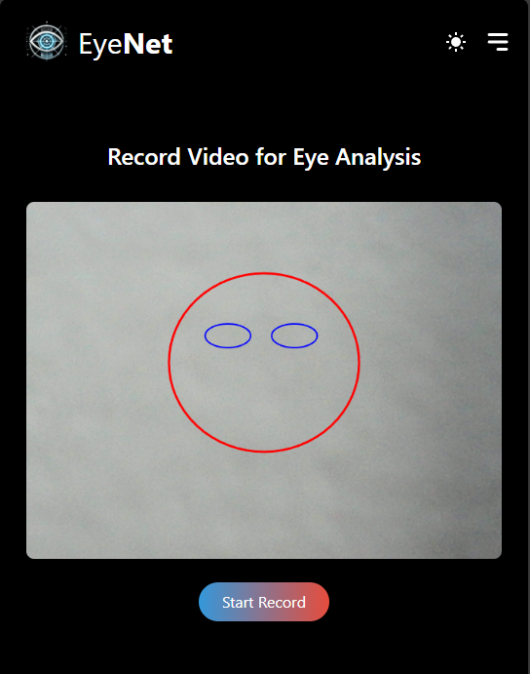

22
Introduction
Proposed Solution
Sys’ Workflow
Face&Eye Detection
DLib
Keras Models
DenseNet121
Attention Mechanism
Architecture
Expected Challenges
Evaluation Plan
GUI
Notes:
Here we can see how each page looks in our application.
The user can record a video, or upload a video or even static image if wants.

Slide 23
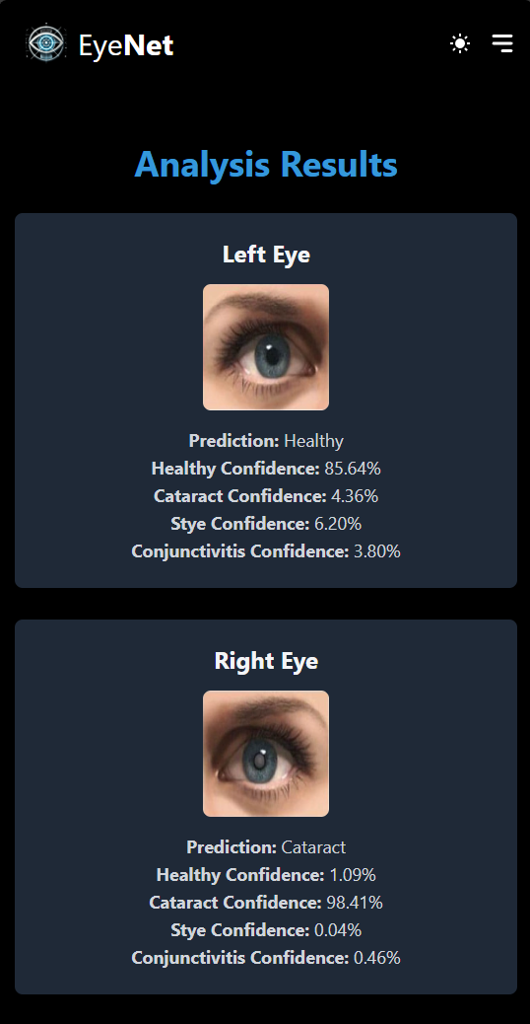
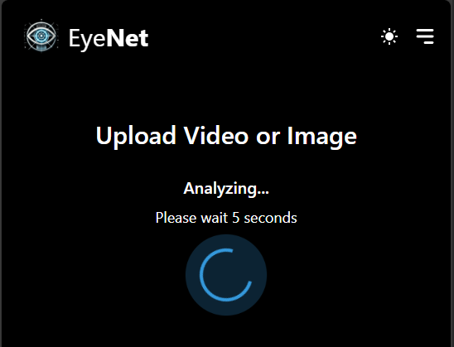
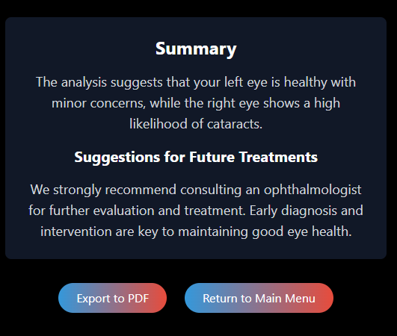
After recording/uploading a video
23
Introduction
Proposed Solution
Sys’ Workflow
Face&Eye Detection
DLib
Keras Models
DenseNet121
Attention Mechanism
Architecture
Expected Challenges
Evaluation Plan
GUI
Notes:
After the user upload/record a video or image.
The system will analyze the video, and display the results for user in a user-friendly interface.
The results will be displayed for each eye left and right, a short summary and suggestions for future treatments.
The main idea is that the user can export the results to pdf, for future treatments.

Slide 24

Thank you for Listening!
24
Notes:
Thank you for listening!

